Slide 1
Boundary Fill Algorithm
This algorithm picks a point inside the polygon and starts to fill until it hits the boundary of the object.
Assumption:
In this algorithm, we assume that color of the boundary is same for the entire object.

Slide 2
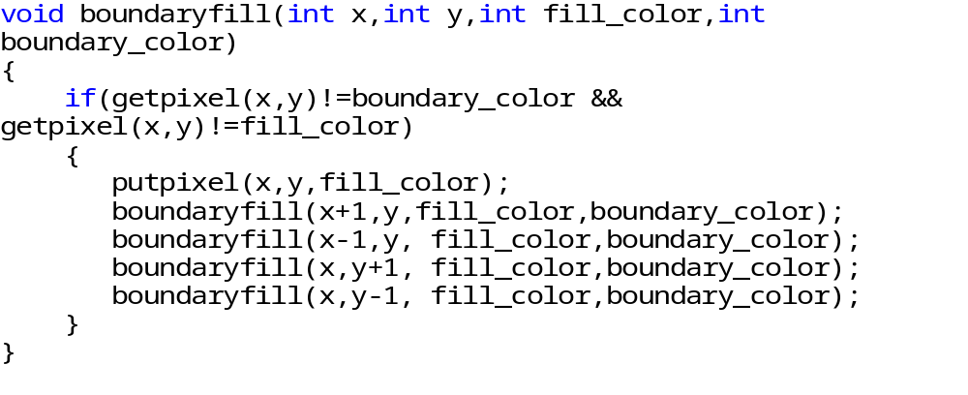
Boundary Fill Algorithm (Code)

Slide 3
Flood Fill Algorithm
Sometimes we want to fill in an area that is not defined within a single color boundary.
We paint such areas by replacing a specified interior color instead of searching for a boundary color value. This approach is called a flood-fill algorithm.

Slide 4
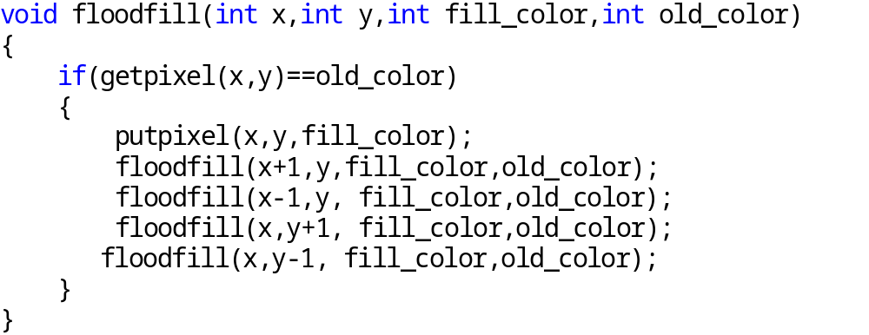
Flood Fill Algorithm (Code)

Slide 5
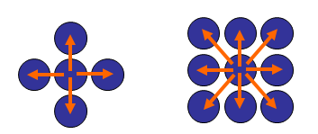
Boundary Fill Algorithm /Flood Fill algorithm
The boundary fill algorithm/ flood fill algorithm can be implemented by 4-connected pixels or 8-connected pixels.

Slide 6
4-connected (Example)
Start Position

Slide 7
3
2
1
1
2
3

Slide 8
4
2
1
1
4
2

Slide 9
2
1
1
2

Slide 10
5
1
5
1

Slide 11
1
1

Slide 12
Some region remains unfilled

Slide 13
8-connected (Example)
Start Position

Slide 14
5
4
3
2
1
4
1
5
2
3

Slide 15
6
4
3
2
1
6
4
1
2
3

Slide 16
8
7
4
3
2
1
7
8
4
1
2
3

Slide 17
12
11
10
9
7
4
3
2
1
11
9
12
7
10
4
1
2
3

Slide 18
11
10
9
7
4
3
2
1
11
9
7
10
4
1
2
3

Slide 19
10
9
7
4
3
2
1
9
7
10
4
1
2
3

Slide 20
9
7
4
3
2
1
9
7
4
1
2
3

Slide 21
7
4
3
2
1
7
4
1
2
3

Slide 22
4
3
2
1
4
1
2
3

Slide 23
3
2
1
1
2
3

Slide 24
2
1
1
2

Slide 25
1
1

